Slide 1
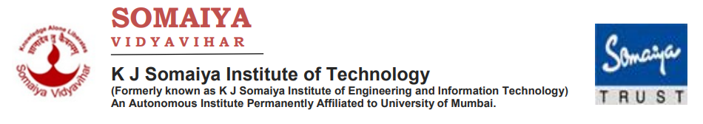


Department of Computer Engineering
Academic Year 2023-24
Natural Language Processing Mini Project
Handwritten Hindi Recognition
Group Members:
Usaid Khan
Manan Salia
Sahil Sahane
Supervisor:
Prof. Abhijit Patil

Slide 2

OUTLINE OF PRESENTATION
Introduction
Summary / Finding of Literature Survey
System Design & Architecture
Proposed Methodology( Algorithm / Flowchart etc.)
Video & Audio demonstration of Running Project(5Mins)
Results
Conclusion
Reference

Slide 3
INTRODUCTION
Handwritten Hindi text recognition is emerging areas of research in the field of optical character recognition.
In our increasingly digital and automated world, Optical Character Recognition (OCR) technology has become a crucial tool for transforming both printed and handwritten text into formats that computers can understand and manipulate. This versatile technology has been applied across a wide range of fields, including document digitization and language processing.
However, the Hindi language presents distinctive challenges to OCR systems due to its intricate script and a wide array of handwriting styles.
The accurate recognition of handwritten Hindi text holds immense importance as it enables the preservation of cultural heritage, improves accessibility, and streamlines administrative and educational tasks in Hindi-speaking regions.

Slide 4
SUMMARY/FINDING OF LITERATURE SURVEY
The purpose of one of the segmentation techniques is to separate the text into lines, lines into words, and words into characters. The segmentation is important for character recognition. The document also provides the methodology for line segmentation, word segmentation, and character segmentation.
The use of Tesseract-OCR was done for document segmentation and translation. The use of Python-tesseract and Googletrans to extract and translate the text. The paper highlights the challenges in segmentation and translation and presents the methodology and implementation details. The results show that the proposed approach can successfully extract and translate text from various languages. The paper concludes by suggesting future work to improve the efficiency and accuracy of the system.

Slide 5
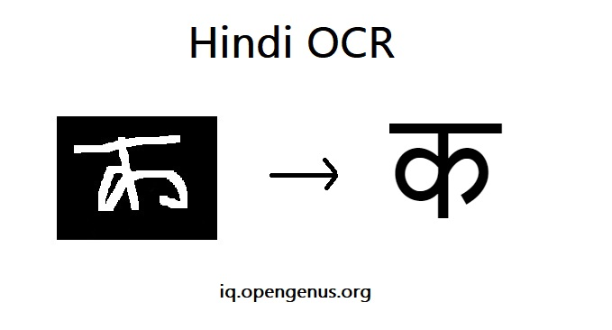
SUMMARY/FINDING OF LITERATURE SURVEY
The authors propose a technique that involves scanning and binarizing the text, followed by segmentation into lines, words, and various components of characters. Feature extraction is performed on each character, and a set of 59 features is selected for recognition.
The proposed approach consists of two major components: training data generation and test data processing. The training data generation involves smart Hindi database selection, training image generation, box file generation, train file generation, character set file generation, font properties selection, feature extraction, clustering, dictionary data preparation, post-processing ambiguity removal, and training data compaction. The test data processing includes recognizing the test image using the training data.

Slide 6
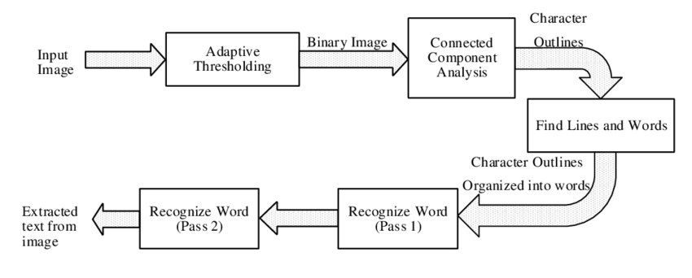
SYSTEM DESIGN AND ARCHITECTURE
Tesseract-OCR, an optical character recognition engine, for document segmentation and translation. The process involves character detection, line finding, baseline fitting, and various other algorithms to detect and read text from the document. Python-tesseract is used to implement Tesseract-OCR and convert the image into text.
The image document is provided as input, and the application detects the language on the image and extracts the text using Tesseract-OCR. The extracted text is then translated into the desired language using Googletrans. The implementation is straightforward, requiring the inclusion of the Python-tesseract module and calling the defined method to convert the image into text.

Slide 7
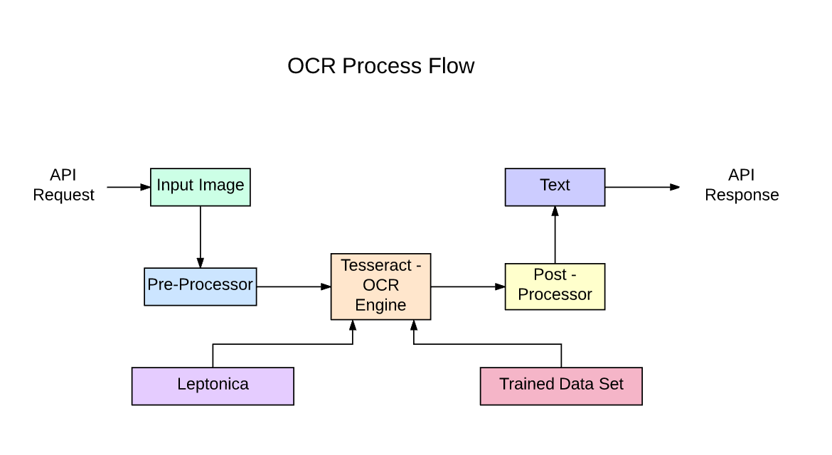
SYSTEM DESIGN AND ARCHITECTURE
The input image is also gray-scaled to improve the overall performance of the output.
SpaCy is an open-source natural language processing (NLP) library designed for a wide range of NLP tasks, such as tokenization, part-of-speech tagging, named entity recognition, dependency parsing, and more. It was developed by Explosion AI, and it's known for its speed, efficiency, and ease of use. SpaCy is implemented in Python and is widely used in both academia and industry for various NLP applications.
When you have scanned or OCR-converted text, it often contains errors, irregularities, and formatting issues that can make it challenging to work with. SpaCy can assist in cleaning and preparing this text for various natural language processing tasks or downstream applications.

Slide 8
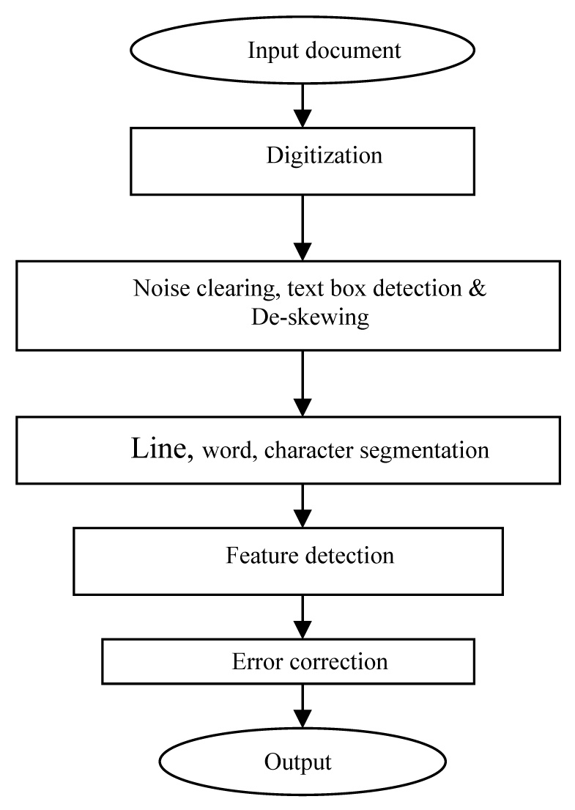
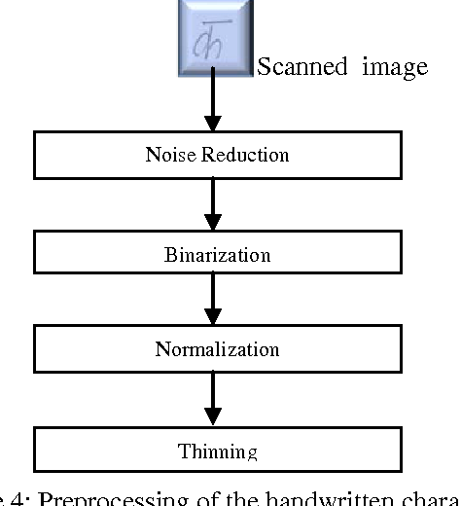
PROPOSED METHODOLOGY

Slide 9
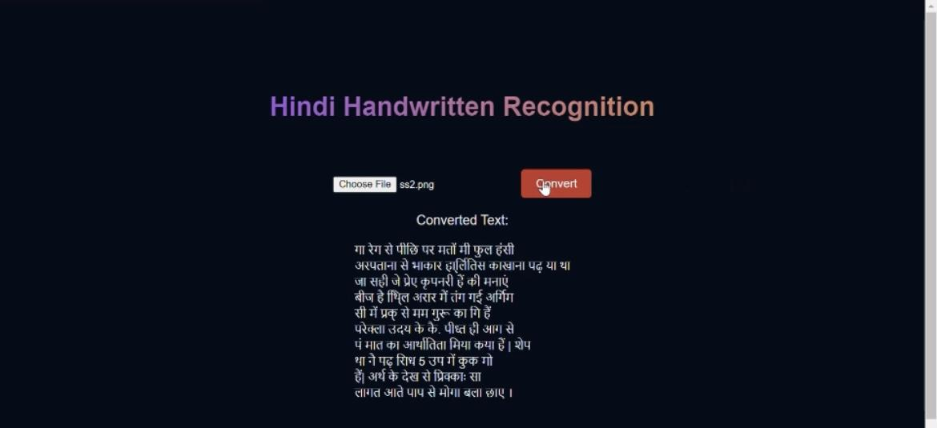
RESULTS

Slide 10
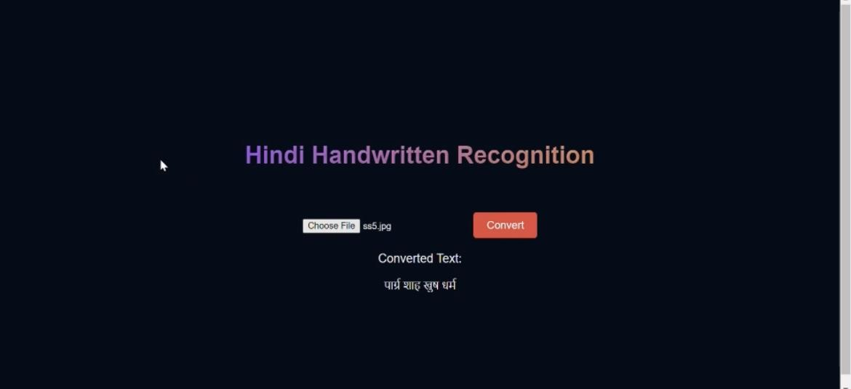
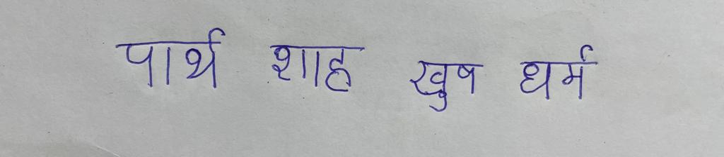
RESULTS

Slide 11
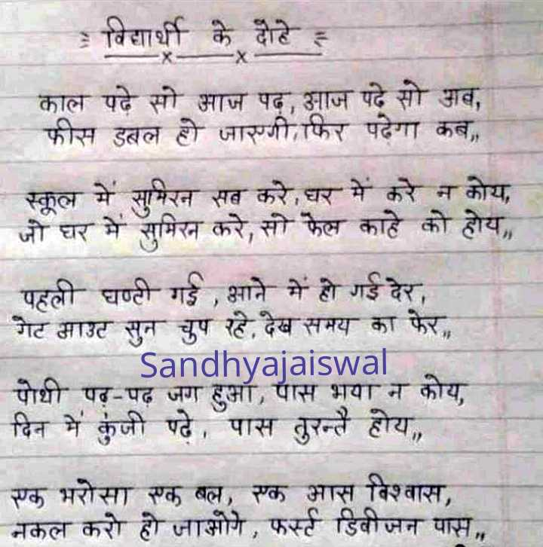
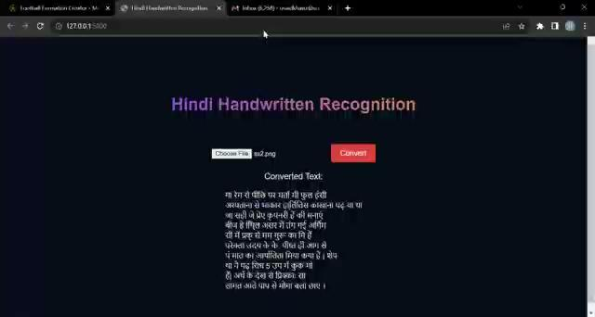
RESULTS

Slide 12
LITERATURE REVIEW
Paper | Methodology | Advantages | Limitations | Results
Segmentation of handwritten Hindi text | This paper centers on the segmentation technique employed for recognizing handwritten Hindi text. It commences with a discussion on the creation of the experimental database, followed by an exploration of the unique characteristics of the Hindi language. Subsequently, it provides an in-depth explanation of the segmentation technique utilized for segmenting handwritten Hindi text. | 1] New Segmentation Technique 2] Database Construction 3] Height of the consonant | 1] Lack of pre-processing 2] Limited discussion on error propagation 3] Limited generalizability | The document presents the results of the segmentation process. The accuracy of text line segmentation is 91.5%, word segmentation is 98.1%, consonant segmentation is 79.12%, ascender segmentation is 95.5%, and descender segmentation is 82.6%.

Slide 13
1. Recognition of Offline Handwritten Hindi Text Using SVM | The paper proposes a segmentation-based approach for recognizing handwritten Hindi text. The text is segmented into lines, lines into words, and words into characters. Shape-based features are extracted from the characters and fed into an SVM classifier for recognition.. | The proposed approach uses shape-based features, which have been found to be very useful for character recognition. The SVM classifier used in the recognition process has shown promising results. The segmentation-based approach allows for better handling of the different writing styles and shapes of characters in handwritten Hindi text. | Segmentation errors can affect the recognition rate, and the overall recognition rate is reduced due to these errors. Similar-shaped characters can create confusion during recognition, leading to lower accuracy. The paper mentions that there is no commercial OCR available for handwritten Hindi text, indicating that further improvements and research are needed in this area. | The recognition rate obtained from correctly segmented characters is 89.6%, which is considered very promising. However, the overall recognition rate is lower due to segmentation errors. The paper also mentions that the obtained results cannot be directly compared with the literature work, as most of the existing work focuses on the recognition of isolated characters.

Slide 14
Document segmentation and language translation using tesseract-ocr | The methodology used in this document involves the use of Tesseract-OCR, Python-tesseract, and Googletrans to perform document segmentation and translation. The pre-processing phase includes operations such as de-skewing, de-noising, character enhancing, and histogram equalization. Pattern recognition techniques, both feature-based and featureless, are used for character recognition. The Tesseract-OCR library is used for optical character recognition, while Googletrans is used for language translation. | The proposed methodology offers several advantages. It allows for the efficient extraction of text from images and its translation into different languages. The use of Tesseract-OCR and Googletrans libraries simplifies the implementation process. The web application developed based on this methodology provides real-time translation of documents, making it convenient for users. | One limitation of the proposed method is that the user has to manually provide the input language. However, efforts are being made to overcome this limitation by working on automatic language detection. Additionally, the segmentation process may face challenges when dealing with handwritten characters or when words are attached or overlapped. | The results of implementing this methodology include the successful extraction of text from images and its translation into the desired language. The web application developed based on this methodology allows users to browse any image and convert the text into the required language. The proposed method has the potential to make documents easily understandable and accessible in different languages.

Slide 15
Shirorekha Chopping Integrated Tesseract OCR Engine for Enhanced Hindi Language Recognition | The proposed methodology involves two major components: Training Data Generation , Data Processing. In Training Data Generation, the Smart Hindi database is selected, training images are generated, box files and train files are created, and character set files and font properties are generated. The features of the characters are extracted and clustered, and dictionary data is prepared. | The proposed approach improves the recognition rate, processing time, and the size of the training database for Hindi language recognition. It allows for the training of conjunct characters and isolated half characters, and has better font variation tolerance compared to existing OCR engines. The integration of Shirorekha Chopping with Tesseract OCR Engine enhances the performance of Hindi language recognition. | The limitations of the proposed approach are not explicitly mentioned in the given document. However, it can be inferred that the approach may have limitations in recognizing handwritten or highly stylized Hindi text, as it primarily focuses on printed text recognition. Additionally, the document does not provide information on the performance of the approach on a large and diverse dataset, which could be a potential limitation. | The experimental results show that the proposed approach achieves a recognition rate of 94.9% with Mangal as the testing font and 86.9% with Krutidev as the testing font. The average recognition rate is significantly enhanced using Shirorekha Chopping. The processing time of the proposed approach is 1000 ms for a test image with 94 characters. The training data size for the proposed approach is 7.5 MB. These results indicate the effectiveness of the proposed approach in improving Hindi language recognition.

Slide 16
Handwritten Hindi Character Recognition using Multiple Classifiers in Machine Learning | The methodology used in this study involves the implementation of various algorithms for handwritten character recognition (HCR). The dataset consisted of 92,000 images of 46 different types of Hindi characters and digits. Techniques like Zoning, Histogram, Principal Components Analysis (PCA), and Gradient-based features were applied to extract the features of individual characters. Classification algorithms such as Support Vector Machine (SVM), Random Forest, Logistic Regression, Naïve Bayes, KNN, SVM, and CNN were used to classify the extracted features and recognize the characters. | The SVM algorithm achieved the highest accuracy of 98.88% in recognizing Hindi characters. Random Forest algorithm achieved an accuracy of 97.22%. Logistic Regression algorithm achieved an accuracy of 95.83%. Naïve Bayes ' algorithm achieved an accuracy of 52.68%. The use of machine learning techniques improved the accuracy of the HCR method. | Linear Regression algorithm achieved an accuracy of only 52.43%, which is relatively low compared to other algorithms. The accuracy of the Naïve Bayes algorithm was also relatively low at 52.68%. The dataset used in this study consisted of handwritten Hindi characters and digits, which may limit the generalizability of the results to other languages or scripts. | The SVM algorithm achieved the highest accuracy of 98.88% in recognizing Hindi characters. Random Forest algorithm achieved an accuracy of 97.22%. Logistic Regression algorithm achieved an accuracy of 95.83%. Naïve Bayes ' algorithm achieved an accuracy of 52.68%. Linear Regression algorithm achieved an accuracy of 52.43%.

Slide 17
A New Method for Line Segmentation of Handwritten Hindi Text | The methodology used in this paper for line segmentation of handwritten Hindi text is based on header line detection, baseline detection, and contour following technique. No preprocessing techniques like skew correction, thinning, or noise removal have been applied to the data. | The method proposed in this paper is suitable for fluctuating lines or variable skew lines of text. It is also invariant to non-uniform skew between words in a line. Additionally, the contour following technique after header line detection helps in correctly separating some of the overlapped lines of text. | The method discussed in this paper does not address the problem of small gaps between lines or overlapping of text lines. It also does not handle lines with broken parts in upper modifiers or lines with thick parts in upper modifiers. Moreover, the method may not work well for lines overlapping within a stripe. | The paper presents the accuracy of line segmentation for handwritten Hindi text. The technique achieved a line segmentation accuracy of 94.5% for variable skew or fluctuating lines. The method was also applied to printed Sanskrit and Hindi text, achieving an accuracy of 97%. However, for handwritten Gurmukhi script, while the header and base lines were correctly identified, there were issues with recognizing vowel modifiers and base lines that were not touching consonants.articles.

Slide 18
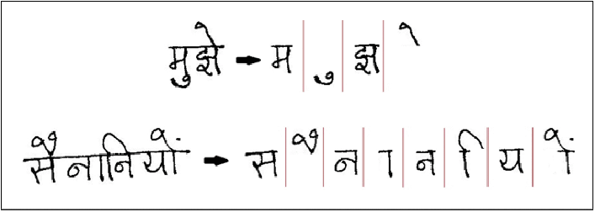
CONCLUSION
In conclusion, our project dedicated to developing a Hindi Handwritten Recognition System utilizing Tesseract OCR represents a significant step forward in the realm of Optical Character Recognition technology.
With the ever-increasing digitalization and automation of our world, the ability to accurately recognize and transcribe handwritten Hindi text has profound implications for preserving cultural heritage, enhancing accessibility, and simplifying administrative and educational tasks in Hindi-speaking communities.
In closing, the successful implementation of a Hindi Handwritten Recognition System using Tesseract OCR is not only a technological achievement but also a testament to our commitment to cultural preservation, accessibility, and efficiency.

Slide 19
REFERENCES
Garg, Naresh Kumar, Lakhwinder Kaur, and M. K. Jindal. "Segmentation of handwritten Hindi text." International Journal of Computer Applications 1.4 (2010): 22-26.
Garg, Naresh Kumar, Lakhwinder Kaur, and Manish Jindal. "Recognition of offline handwritten hindi text using SVM." International Journal of Image Processing (IJIP) 7.4 (2013): 395-401.
Thakare, Sahil, et al. "Document segmentation and language translation using tesseract-ocr." 2018 IEEE 13th International Conference on Industrial and Information Systems (ICIIS). IEEE, 2018.
Mishra, Nitin, et al. "Shirorekha chopping integrated tesseract ocr engine for enhanced hindi language recognition." International Journal of Computer Applications 39.6 (2012): 19-23.
Kaur, Jaspreet, Vishal Goyal, and Manish Kumar. "Tesseract OCR for Hindi Typewritten Documents." 2021 Sixth International Conference on Image Information Processing (ICIIP). Vol. 6. IEEE, 2021.
Haque, Md Ziaul, and Mohd Omar. "Handwritten Hindi Character Recognition using Multiple Classifiers in Machine Learning."

Slide 20
THANK YOU

